Slide 1
Project Presentation
On
Exploring optimization problems on Cayley Tree:
Theory and Experiments
Under Guidance :
Dr. Sukanta Das
Associate Professor
IIEST Shibpur
Contributed By :
Pravin Kumar - 2020itb093
Panyam Hema - 2020itb103
Ramavath Nokshith- 2020itb086

Slide 2
Presentation Contents
01
Introduction of Cayley tree
02
Model Framework
Table of Contents
Proposed Model & simulation
03
Optimization Problems
Maximum and Minimization Problems
04
Model Experimentation
Algorithm and simulation on set of natural numbers
05
Conclusion & Discussion
Summary, challenges & future scope

Slide 3
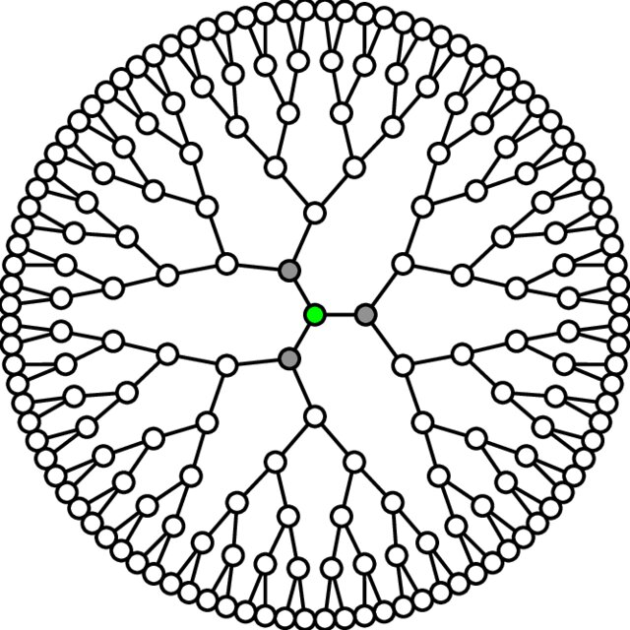
Introduction of Cayley Tree
A Cayley tree, also known as a Bethe lattice, is a connected, acyclic graph with a hierarchical structure.
Each node is connected to a fixed no of child nodes.
It forms a regular and recursive pattern.
In a cayley tree of order n, each node has exactly n no of children, with only root node having n+1 children.

Slide 4
Special Case of Cayley Tree (Order n = 2)
Root node has three children, each intermediate node has two children and leaf node has no children.
No. of nodes at a given height h,
Formula : n=(3 x 2^h) - 2 if h>=0
A Cayley tree with height of h = 3 has 22 nodes.

Slide 5
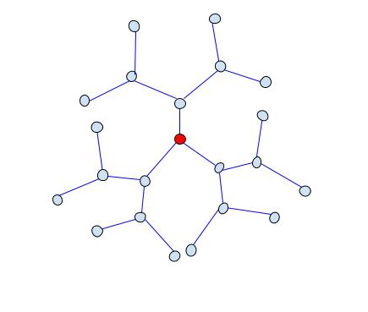
Visualizing the cayley tree
Height h = 3 and total no of nodes is 22.
Root node at central position.

Slide 6
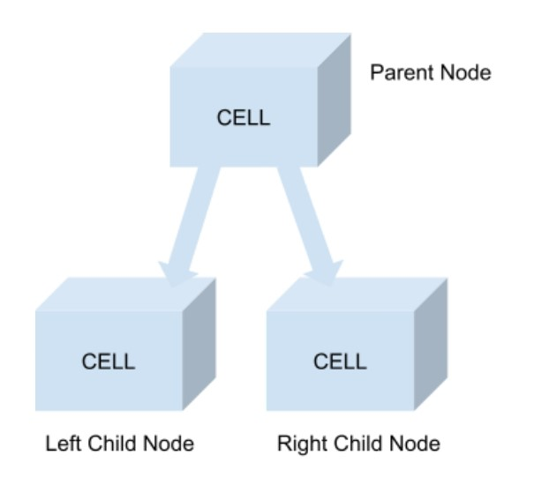
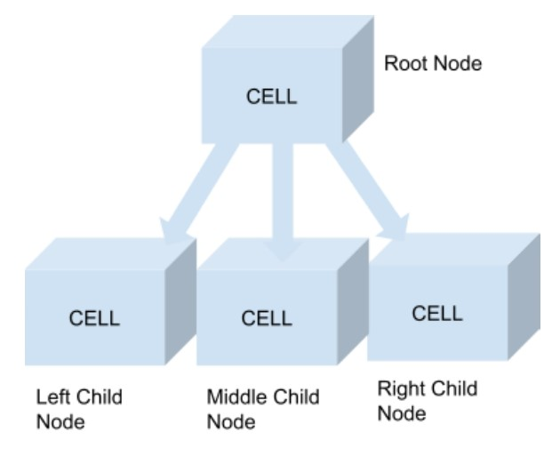
Root node and Intermediate node structure
Root node has three children.
Intermediate node has two children.

Slide 7
Model Framework

Slide 8
Proposed Computational Model
The model resembles a network structure where each cell with processing element represent a node in cayley tree.
Each node Consist of three components: State, Flag register and Memory Element.
Along with It also contains three function send(), Recv() and G().

Slide 9
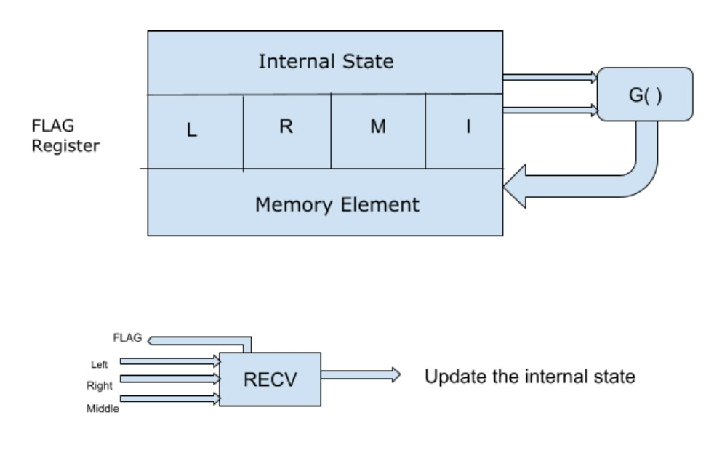
Structure of root node in proposed model

Slide 10
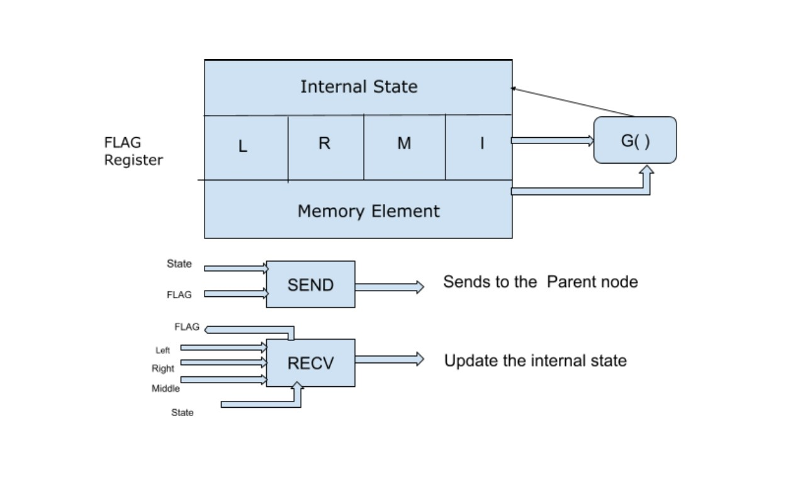
Structure of other node in proposed model

Slide 11
Node Components
State: Represent the current condition or status of the node.
Flag Register : A four bit register with distinct functions managing incoming signals and node activity.
Memory Element: it is used to store data for computational purpose and using a 32 bit left shift register.

Slide 12
Flag Register
Flag[0]: indicates incoming signal from left child nodes.
Flag[1]: Indicates incoming signal from right child nodes.
Flag[2]: Incoming signals from middle child nodes for root node and current state for other nodes.
Flag[3]: Indicates node is active or not.

Slide 13
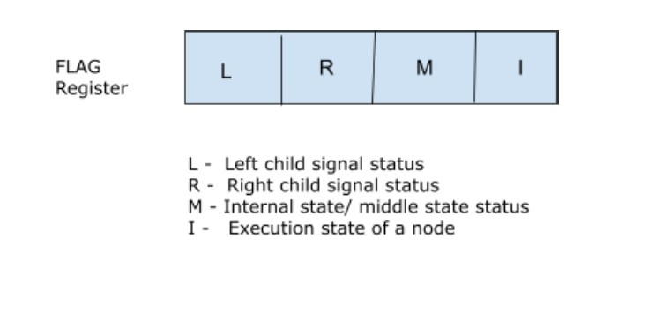
Flag Register

Slide 14
Node Functions
Send(): this function used to send the node state too its parent node.
Recv(): using this node receives signal from its child nodes.
G(): It is used to bind the memory to the node current state.
Fun(): It is used to compare the child states and memory element and final result stored in current state of node.

Slide 15
Model Processing
Each clock pulse begins a computational cycle among all nodes.
Each Node receives signal from child node via Recv(), Update their state via G(), and send state via send() to its parent node.
Execution continues until entire memory has been processed.

Slide 16
Model Simulation
It begins from initial configuration.
Each node receive, update and sending the signals at each cycle.
Each node is executing but initially leaf node send the signal to upper nodes.
These signals transmitted upward and reaches to the root node.
Upon completing the computation cycle, the root node obtains the final resultant value(maximum or minimum).

Slide 17
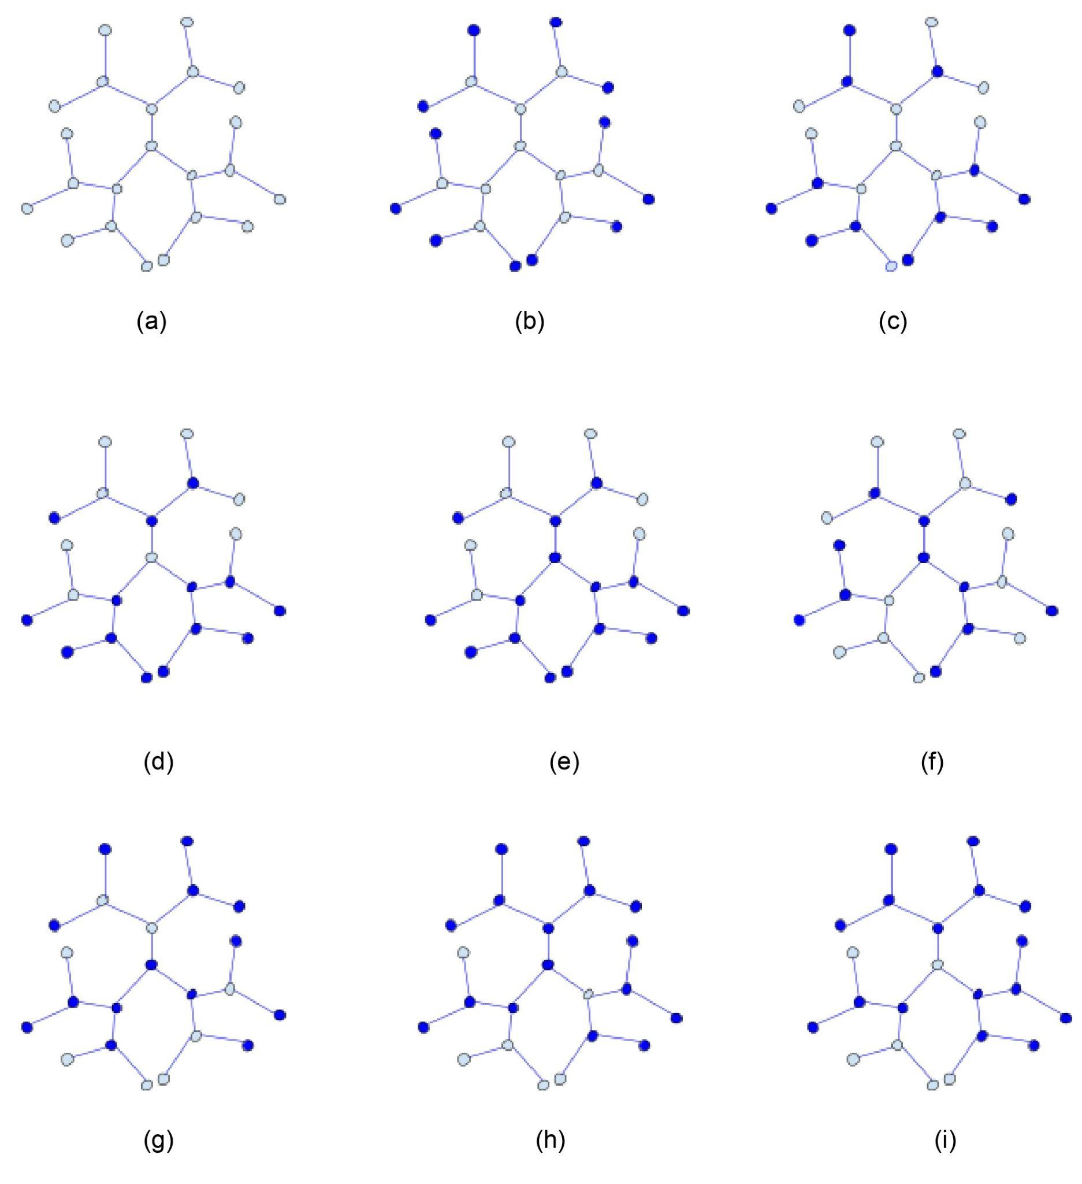
Model Simulation
A demonstration of solving optimization problems through parallel computations.

Slide 18
Application of cayley tree in optimization problems

Slide 19
In-Memory Computing Implementation
Our computational model designed on this concept.
The computation performed by this model directly
Within the memory.
After completion of computation, the final value stored at root node.
It reduces the cpu overhead and workload.
Effectively solve optimization problems for large dataset.

Slide 20
Optimization Problems
Two optimization problems our proposed model focusing on.
Finding Maximum and Minimum values within sequence of natural numbers.
In array based it takes O(n).
In cayley tree it takes O(log n) due to parallel computations.

Slide 21
Maximization Problems
A sequence of natural numbers distributed on each node of cayley tree except root node.
After final computation process, the root node contains max value.
During this process each node involve in their computing operations.

Slide 22
Computational process at each node
At Root node
root node receives signals from its three children.
After comparing among three signals and based on flag register it stores the max signal value in its memory.
Memory shifted left to store the next signal value.
Once memory gets full then it contains max value and root node stop the execution.

Slide 23
Computational process at each node
At Intermediate node -
Intermediate node receives signals from its two children. After comparing with two children state and its memory element.
It updates the current state with maximum value obtained from the result.
It send the updated current state to its parent node.

Slide 24
Computational process at each node
At Leaf node -
Leaf node with no children, treated its child node state as 0.
After compairing the child state and its memory element, it update the current state with maximum value obtained from it.
Then it send the state to its parent node.

Slide 25
Memory used as left shift register
Using left shift register, memory value shift one position to the left on each clock pulse.
It reduces extra memory consumption and eliminates the need for counter registers.

Slide 26
Minimization Problem
Similar to the maximum problem process,
Instead taking maximum signals, it takes minimum signals from its child node.
And update its state. Then send it to its parent node.
Finally, root node contains the minimum value.

Slide 27
Experiment Procedures

Slide 28
For Maximization Problem
Number of elements: 22 (n = 22)
Elements: X = [14, 2, 13, 11, 9, 11, 2, 13, 10, 2, 3, 8, 6, 5, 9, 2, 1, 7, 8, 2, 12, 7]
Cayley tree height: h = 4
Cayley tree order: η = 2
Number of nodes in the tree: 22
After Distribution of elements over nodes.
Finally, Root node contains a maximum value of 14.

Slide 29
Simulation configuration
Fig i. to viii. illustrates the structure of the tree and describes each node execution.
It shows from initial configuration to final configuration state.
Final configuration, root node contains max value.

Slide 30
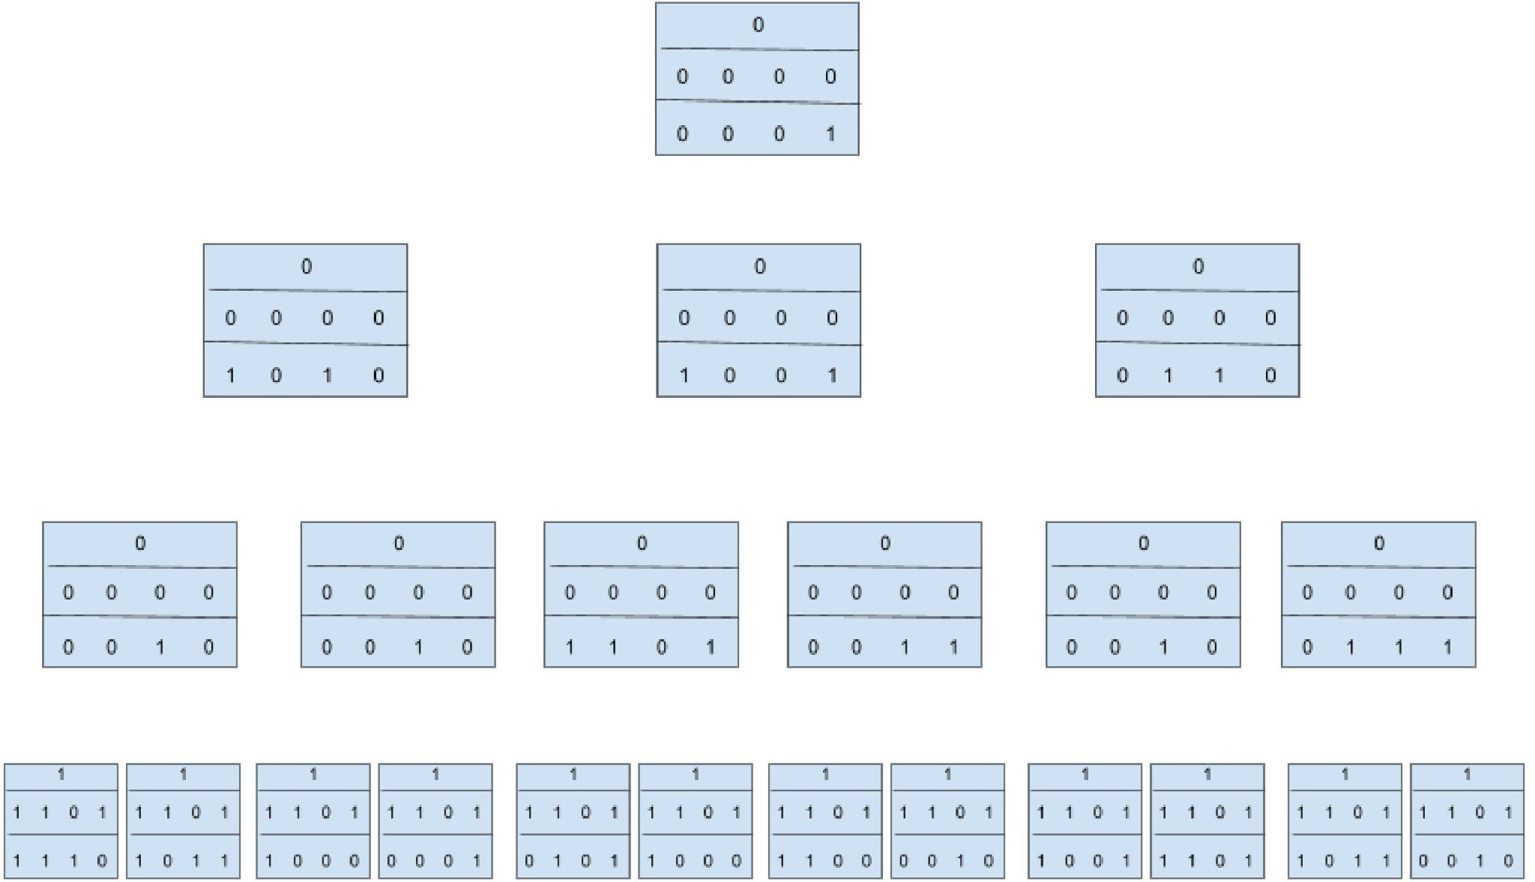
Simulation configuration

Slide 31
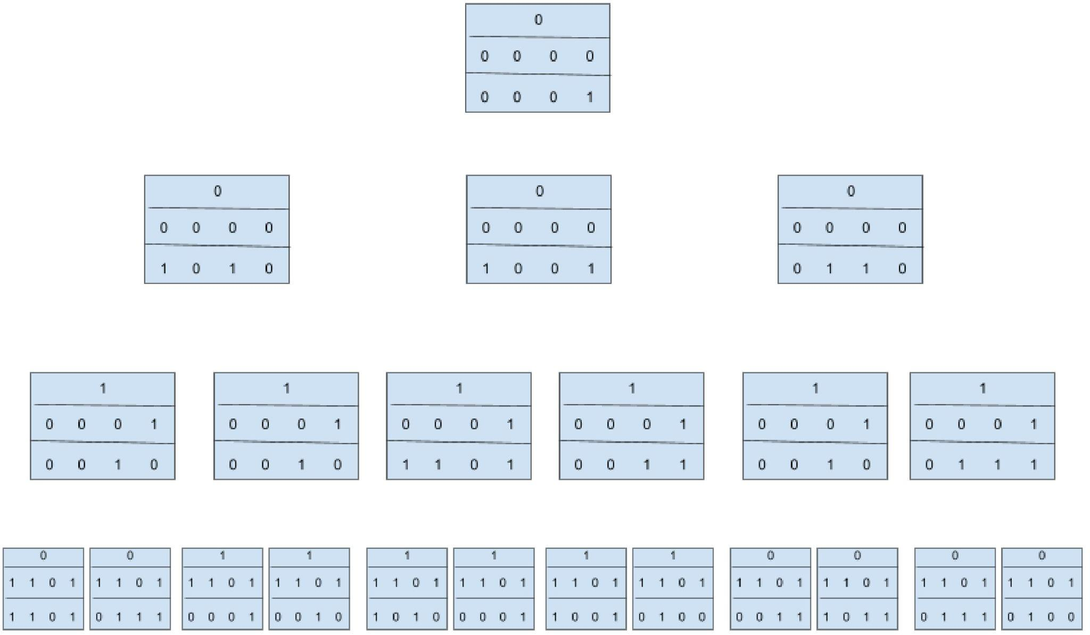
Simulation configuration

Slide 32
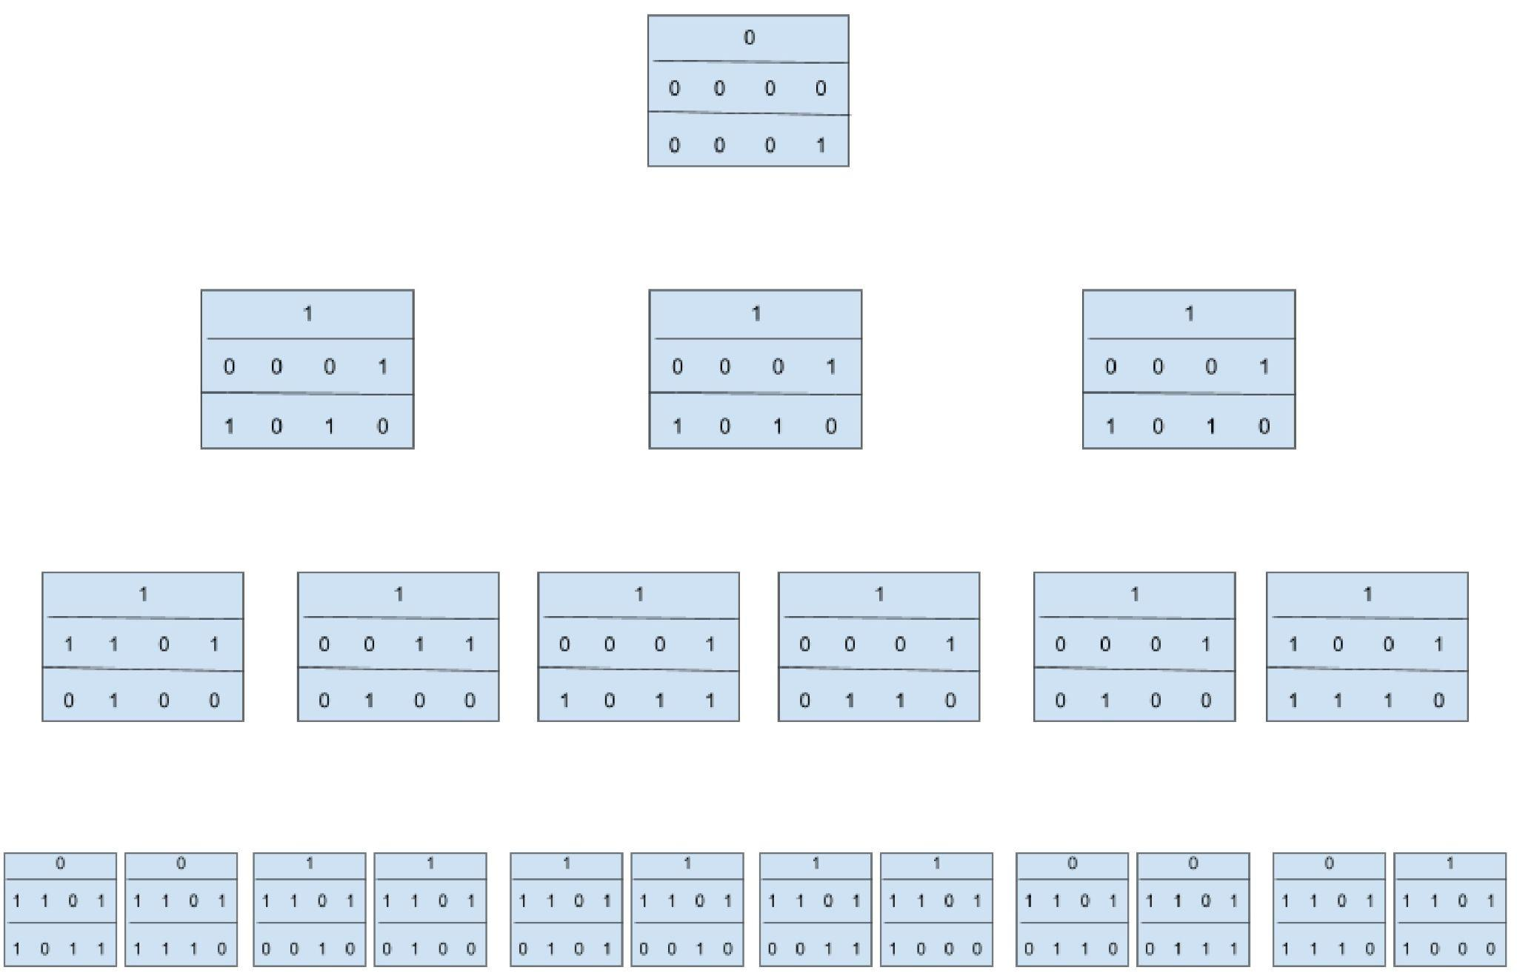
Simulation configuration

Slide 33
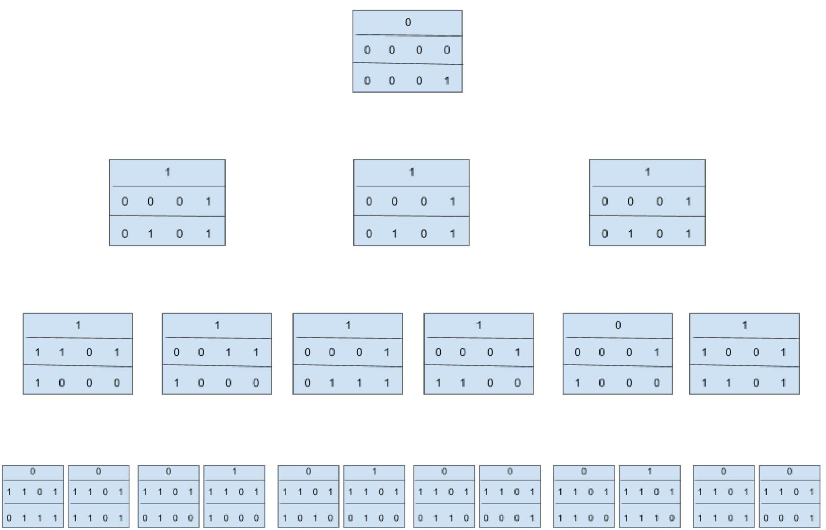
Simulation configuration

Slide 34
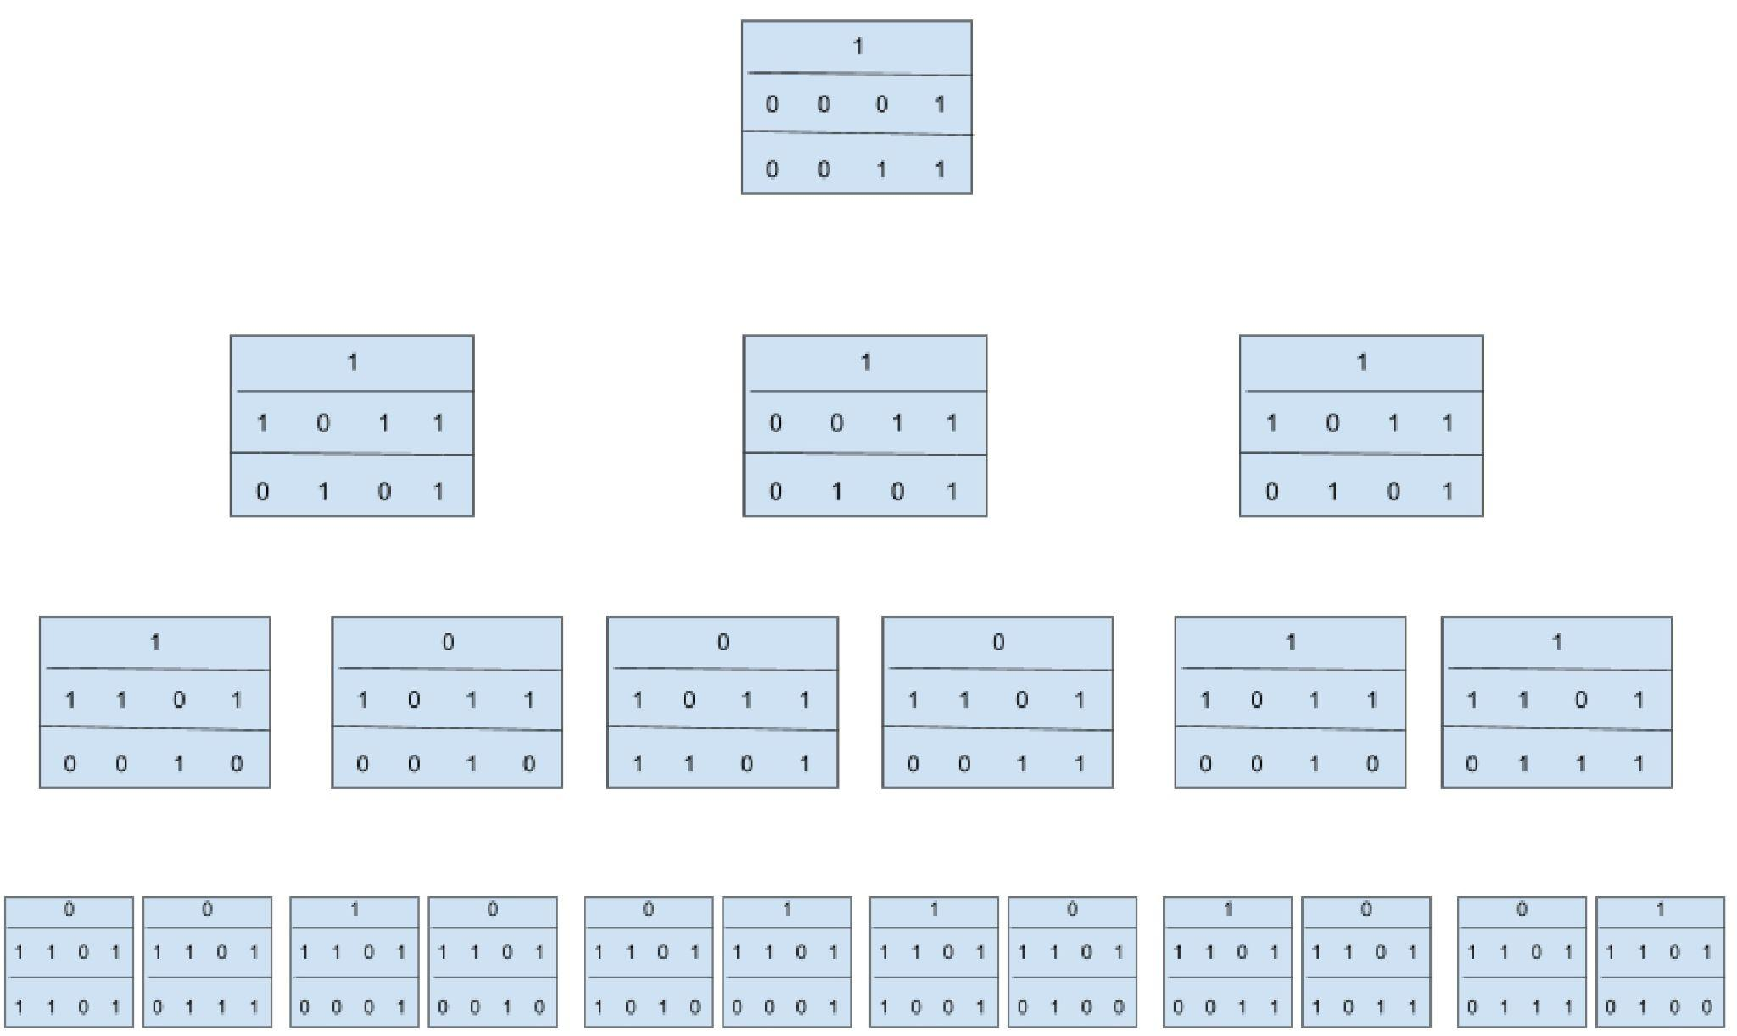
Simulation configuration

Slide 35
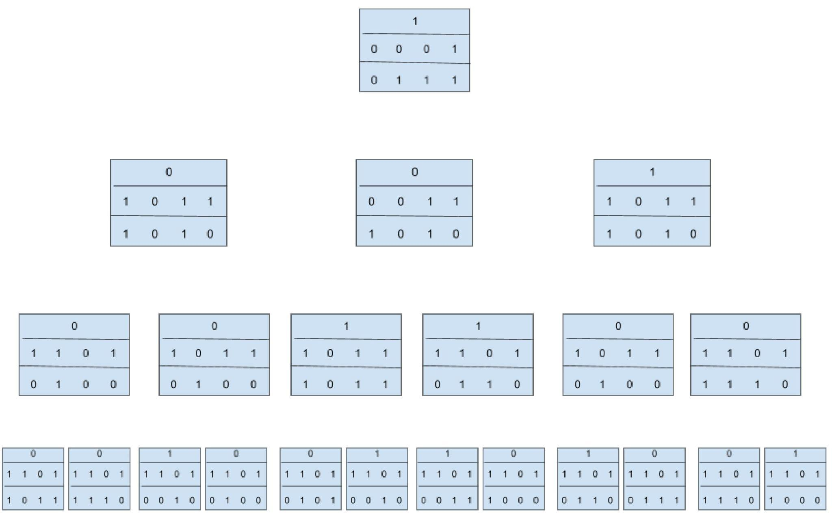
Simulation configuration

Slide 36
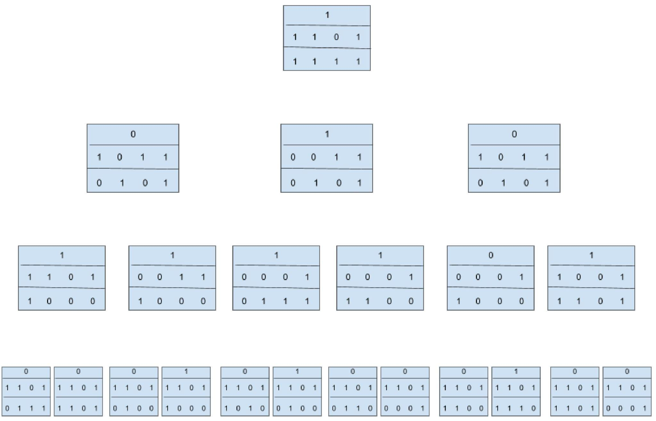
Simulation configuration

Slide 37
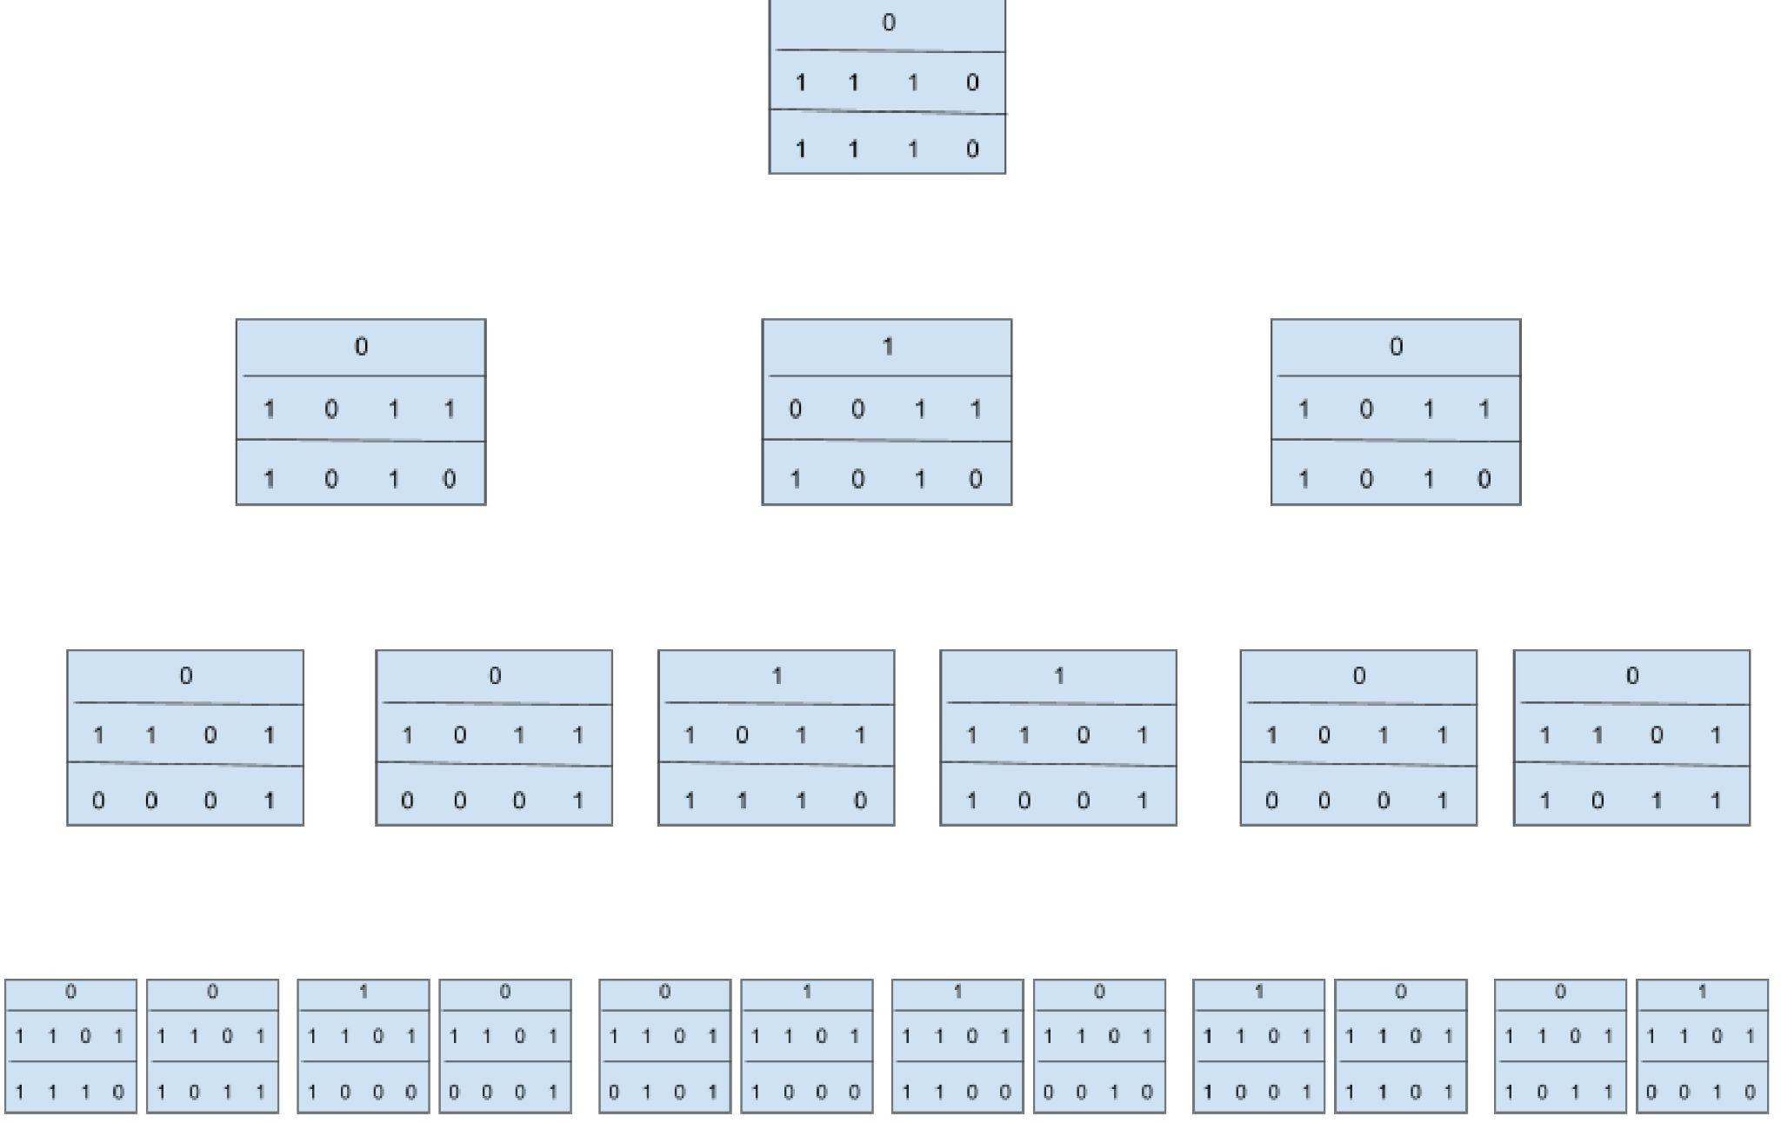
Simulation configuration - viii (final)

Slide 38
For Minimization Problem
Number of elements: 22 (n = 22)
Elements: X = [14, 2, 13, 11, 9, 11, 2, 13, 10, 2, 3, 8, 6, 5, 9, 2, 1, 7, 8, 2, 12, 7]
Cayley tree height: h = 4
Cayley tree order: η = 2
Number of nodes in the tree: 22
After Distribution of elements over nodes.
Finally, Root node contains a minimum value of 1.

Slide 39
Time complexity
In both case it takes O(log n) for all cases.
Whether elements are sorted or not the time complexity is fixed.

Slide 40
Conclusion & discussion
It shows that how our computational model addressing some optimization problems through innovative approaches.
Instead left shift register, we can use counter register for storing index of memory.
This study shows the caleye tree properties and its uses in optimization problems.
The time complexity O(logn) due to parallel computational process.

Slide 41
Challenges and future directions
In memory register, if takes left shift register then other nodes can not retain values due to continuous shifting.
If uses counter register it takes extra memory.
It can be one challenges.
For future direction, finding solutions for other optimization problems such as sorting problem using this model.

Slide 42
References
[1] HASAN AKIN. Cellular automata on cayley tree. arXiv preprint arXiv:1211.7362, 2012.
[2] Hasan Akın and Chih-Hung Chang. The entropy and reversibility of cellular automata on cayley tree. International Journal of Bifurcation and Chaos, 30(04):2050061, 2020.
[3] Sukanta Das. Game of Life, Athenian Democracy and Computation, pages 159–169. Springer International Publishing, Cham, 2022.
[4] Yueting Li, Tianshuo Bai, Xinyi Xu, Yundong Zhang, Bi Wu, Hao Cai, Biao Pan, and Weisheng Zhao. A survey of mram-centric computing: From near memory to in memory. IEEE Transactions on Emerging Topics in Computing, 2022.
[5] Massimo Ostilli. Cayley trees and bethe lattices: A concise analysis for mathematicians and physicists. Physica A: Statistical Mechanics and its Applications, 391(12):3417–3423, 2012.
[6] Subrata Paul. Cellular automata: Temporal stochasticity and computability. arXiv preprint arXiv:2210.13971, 2022.

Slide 43

Thank You

